Slide 1

We’ve got an eavesdropper!

Slide 2





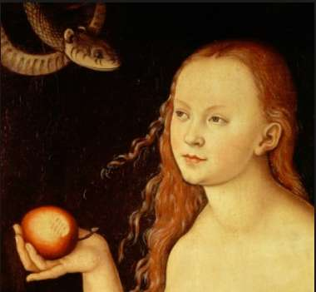

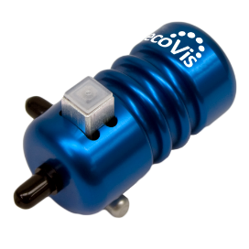
Photon polarization Alice sends
Eve’s random measuring basis
Polarization Eve measures and sends
Bob's random measuring basis
Photon polarization Bob measures
1
0
1
0
1
0
1
0
single-photon light source

Slide 3





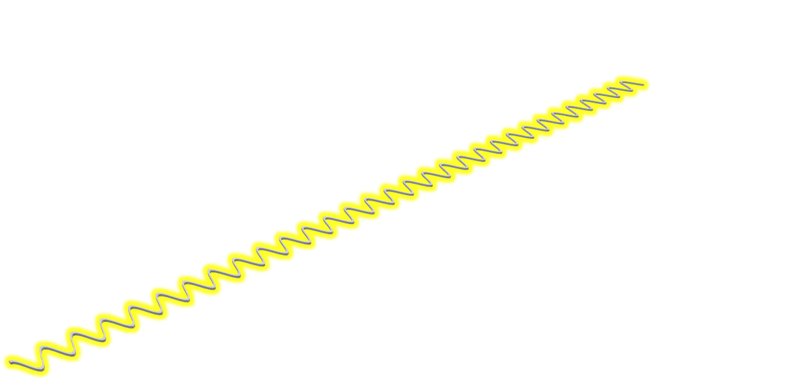
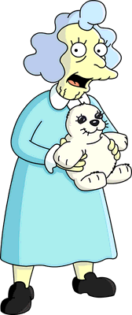
Photon polarization Alice sends
Eve’s random measuring basis
Polarization Eve measures and sends
Bob's random measuring basis
Photon polarization Bob measures
1
0
1
0
1
0
1
0
single-photon light source

Slide 4





Photon polarization Alice sends
Eve’s random measuring basis
Polarization Eve measures and sends
Bob's random measuring basis
Photon polarization Bob measures
1
0
1
0
1
0
1
0
single-photon light source

Slide 5



Photon polarization Alice sends
Eve’s random measuring basis
Polarization Eve measures and sends
Bob's random measuring basis
Photon polarization Bob measures
1
0
1
0
1
0
1
0
single-photon light source

Slide 6



Photon polarization Alice sends
Eve’s random measuring basis
Polarization Eve measures and sends
Bob's random measuring basis
Photon polarization Bob measures
1
0
1
0
1
0
1
0
single-photon light source

Slide 7



Photon polarization Alice sends
Eve’s random measuring basis
Polarization Eve measures and sends
Bob's random measuring basis
Photon polarization Bob measures
1
0
1
0
1
0
1
0
single-photon light source

Slide 8
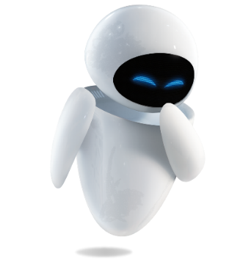
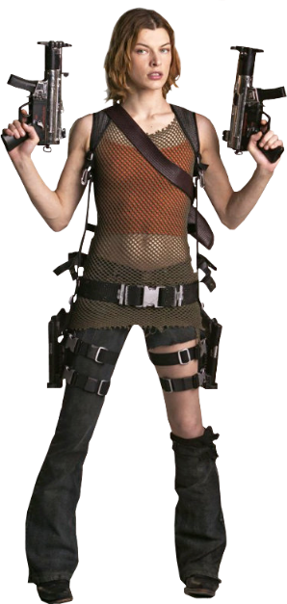

Photon polarization Alice sends
Eve’s random measuring basis
Polarization Eve measures and sends
Bob's random measuring basis
Photon polarization Bob measures
1
0
1
0
1
0
1
0
single-photon light source

Slide 9


Photon polarization Alice sends
Eve’s random measuring basis
Polarization Eve measures and sends
Bob's random measuring basis
Photon polarization Bob measures
1
0
1
0
1
0
1
0
single-photon light source

Slide 10




Back on the classic channel…
Photon polarization Alice sends
Alice’s sending basis
Eve’s random measuring basis
Polarization Eve measures and sends
Bob's random measuring basis
Photon polarization Bob measures
PUBLIS DISCUSSION OF BASIS
Shared secret key
Errors in key
✓
✓

Slide 11

What do we do now?
(Assuming Alice chooses randomly) the probability Eve chooses the incorrect basis is 50%.
If Bob measures Eve’s photon in the same basis that Alice sent, he gets a random result, i.e., an incorrect result with probability of 50%.
So, the probability an intercepted photon generates an error in the key string is then 50% × 50% = 25%
Alice and Bob will then publicly compare $n$ of their key bits. The probability of finding mis-matched bits and the eavesdropper is
$P=1 −{(\frac{3}{4})}^{n}$
So, to detect an eavesdropper with probability 99.9999999%, Alice and Bob would only need to compare 72 bits.

Slide 12
The Steps
Alice sends a bunch of qubits
Random bits with random polarizations
Bob measures the qubits
With either rectilinear (+) or diagonal (X) basis
Bob and Alice find out which qubits were measured correctly by publicly comparing each others’ basiseseses
The bits with matching basis become the key
They publicly compare a set of those bits
if they match, the remaining bits become the key
If they don’t match, there may have been an eavesdropper. So they start all over again.

Slide 13


